Slide 1
Problem statement 1
Display the profit distribution across all segments using boxplots.
Identify outliers (if any) in each segment.
Would you consider the product being sold at a loss as outliers even if the data points are inside the whiskers?

Slide 2
Problem Statement 2
Display the names of the products, their segments, and the number of units sold where the percentage of profit earned is 50%.
Identify and write down the names of the top two selling products (based on quantity sold) in each segment.
Note: The Expected Output is provided in the upcoming slide.

Slide 3
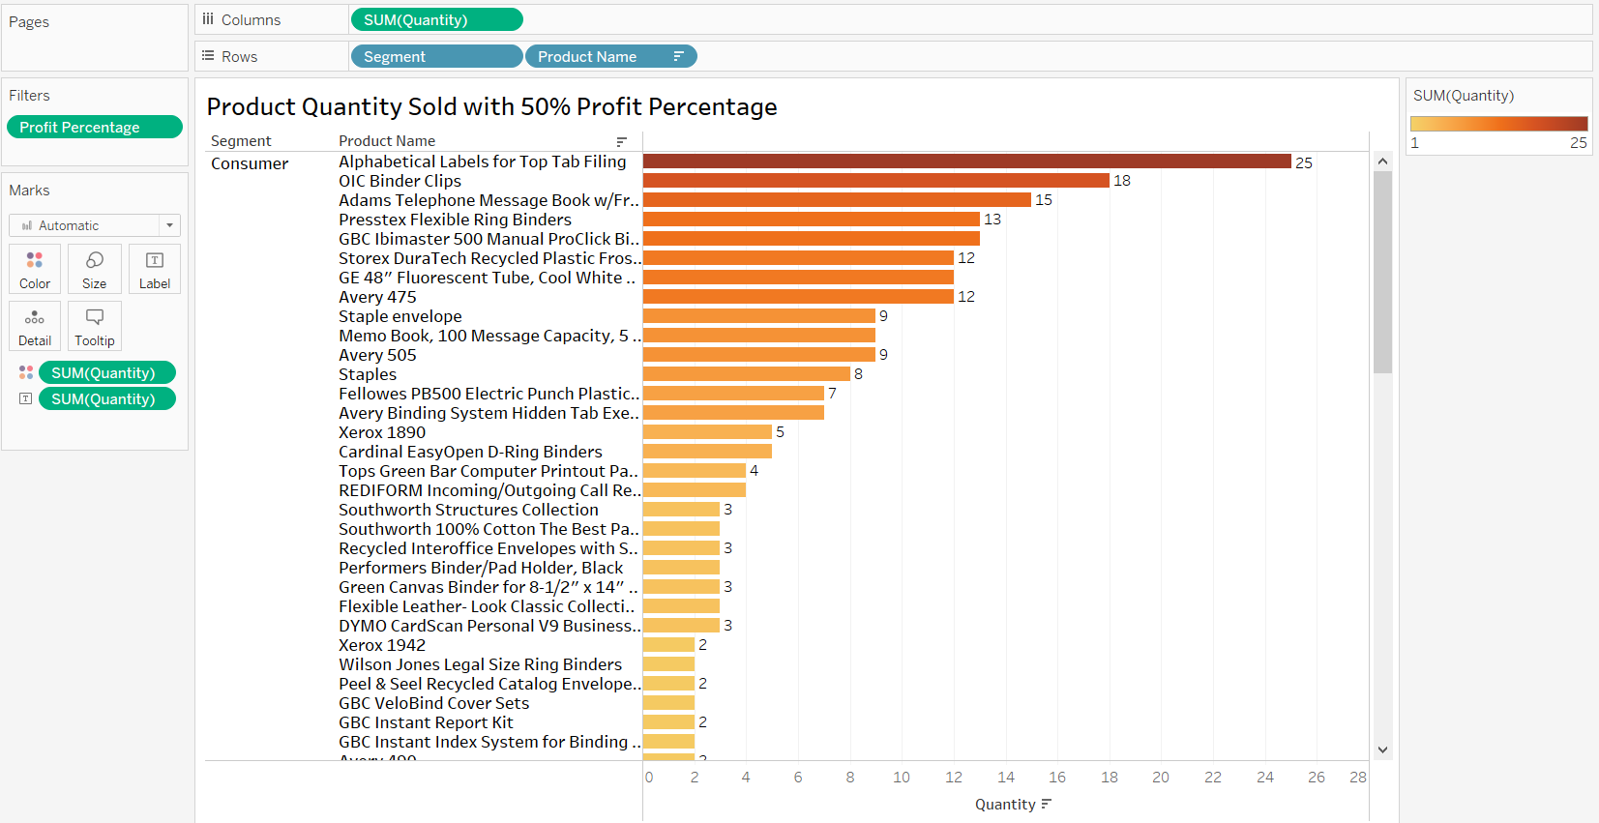
Expected output of problem 2

Slide 4
Problem statement 3
Display the market share (based on sales) of each segment using a pie chart.

Slide 5
Problem Statement 4
Display subcategory-wise quarterly sales for the Consumer segment using dot strip plot with the average line, for the year 2017 (order date).
Is the average sale of products in the Consumer segment increasing every quarter?
Note: The Expected Output is provided in the upcoming slide.

Slide 6
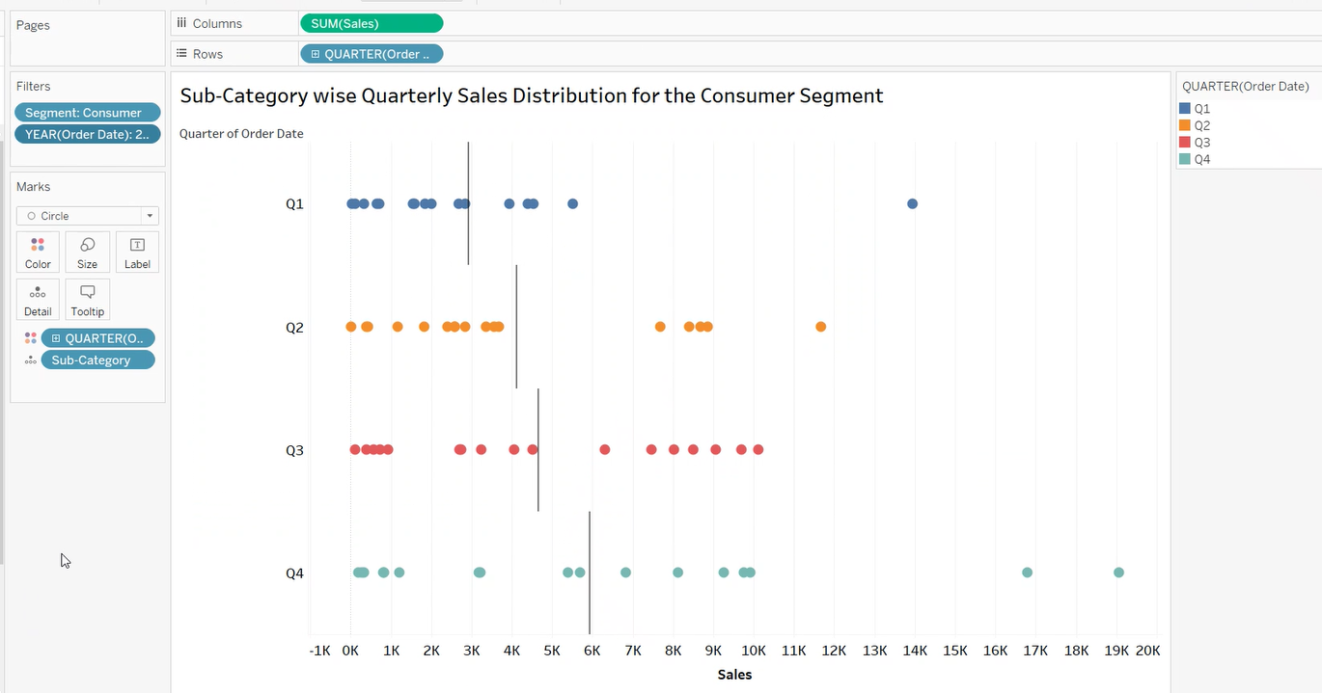
Expected output for problem 4

Slide 7
Problem Statement 5
Display subcategory-wise quarterly sales in the Consumer segment for the year 2017 (order date) using a stacked column chart.
Identify and write down the three product subcategories where the sales are consistently increasing quarter over quarter.
Note: The Expected Output is provided in the upcoming slide.

Slide 8
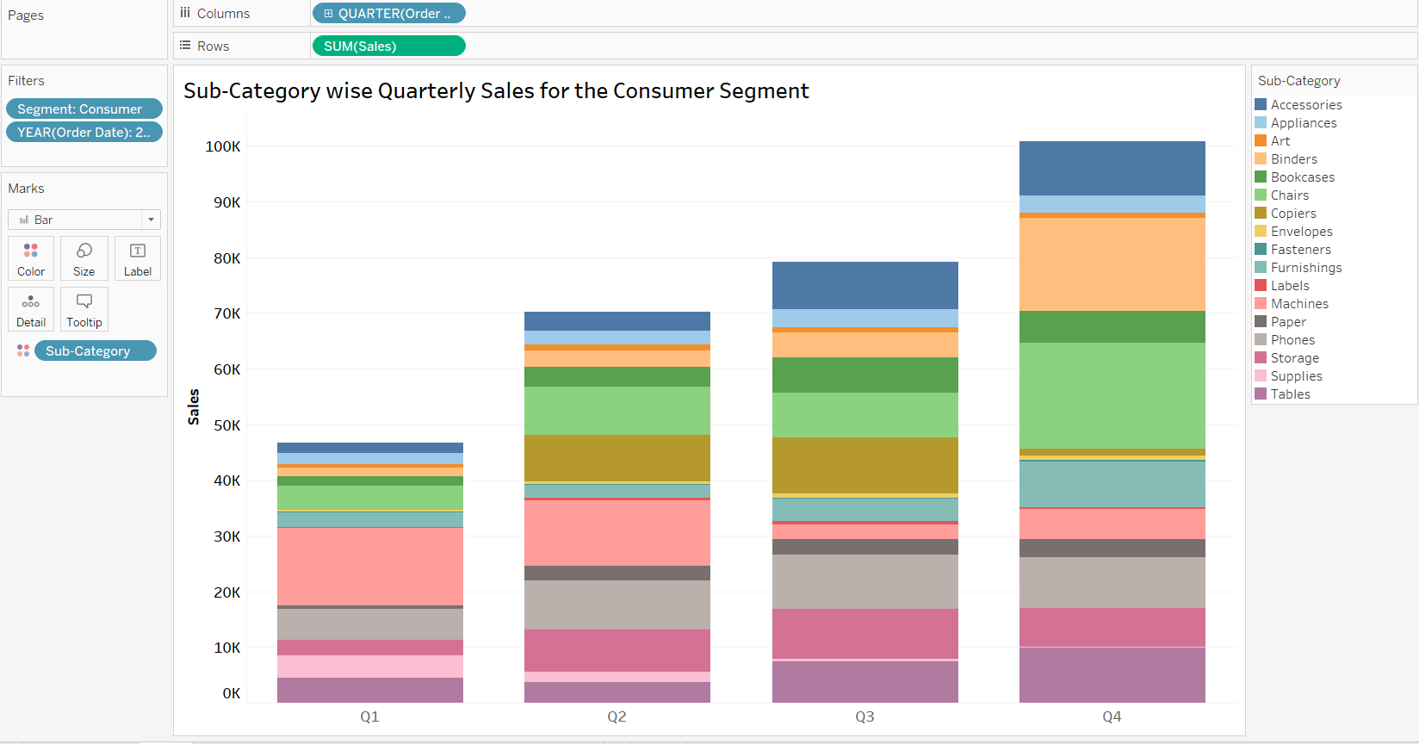
Expected output for problem 5

Slide 9
Problem Statement 6
Display subcategory-wise variation in annual sales for the years 2015 to 2018 using a stacked column chart.
Display subcategory-wise variation in annual profit for the years 2015 to 2018 using a stacked column chart.
Identify the subcategory where the sales and profit increased year after year.
Note: The Expected Output is provided in the upcoming slides.

Slide 10
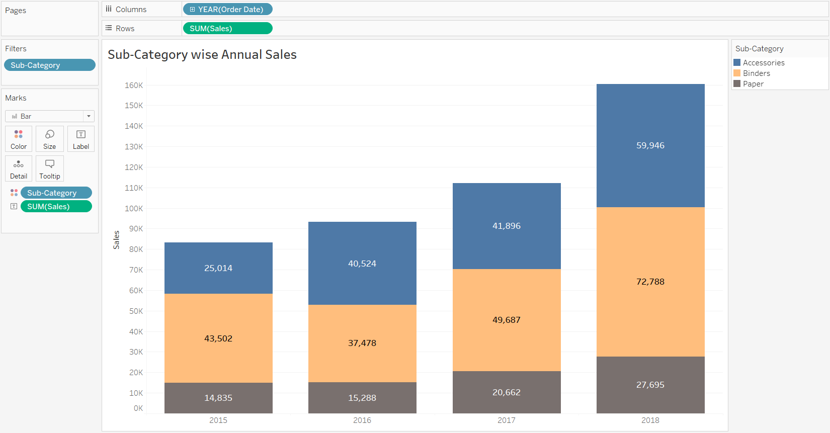
Expected output of part (a)

Slide 11
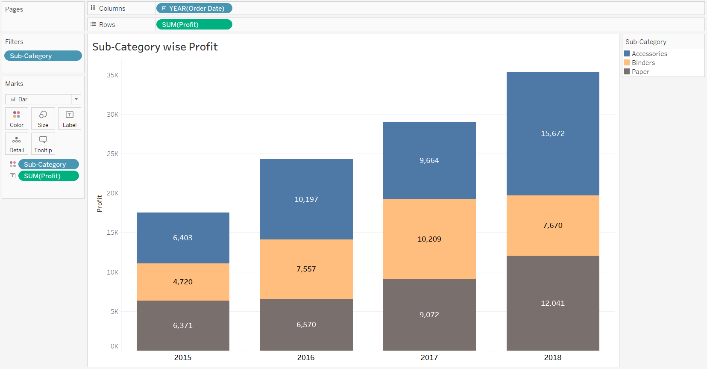
Expected output of part (b)

Slide 12
Problem Statement 7
Display the state-wise profit using a choropleth map chart.
Identify the state with the highest profit.
Note: The Expected Output is provided in the upcoming slide

Slide 13
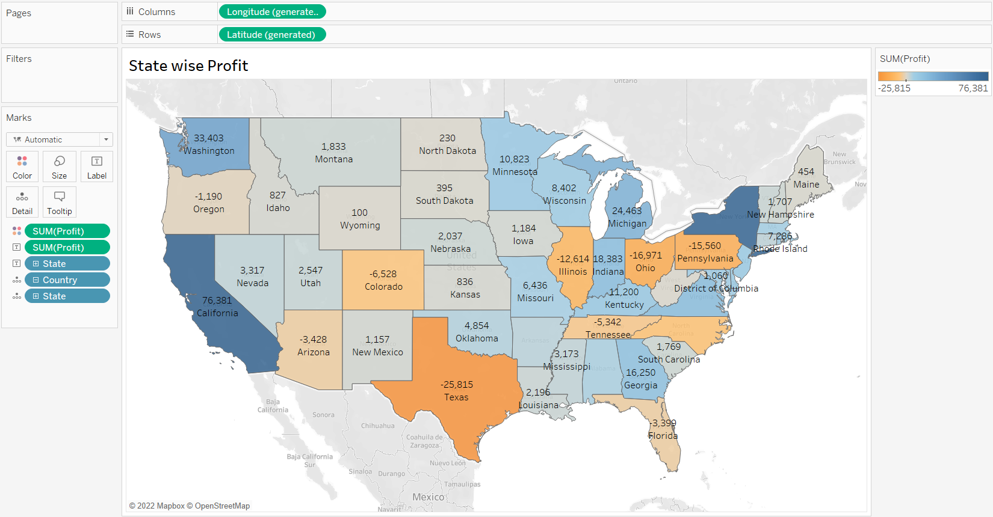
Expected output

Slide 14
Problem statement 8
Display subcategory-wise total profit amount and city name in the state of California for the Consumer segment using a bar code plot.
Identify and write down the top three subcategories with the highest profit distribution.
Identify and write down the top three cities generating the highest profit.
Note: The Expected Output is provided in the upcoming slide.

Slide 15
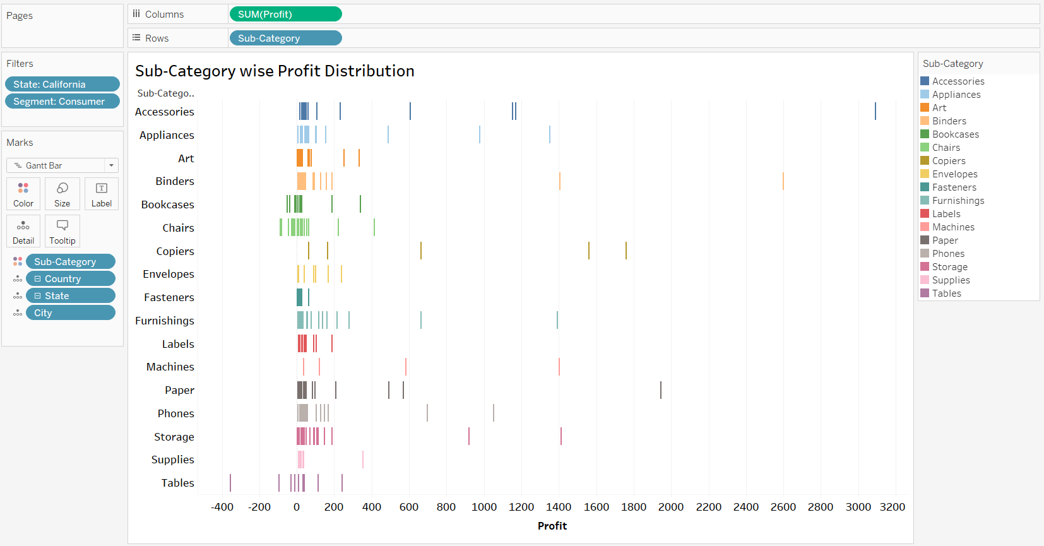
Expected output for problem 8

Slide 16
Problem Statement 9
Display subcategory-wise profit for the Consumer segment using a divergence chart. Identify and write down the subcategories that are making losses.
Display the names of the top 5 products from the above subcategories that are contributing towards the loss using a bar chart.
Note: The Expected Output is provided in the upcoming slide

Slide 17
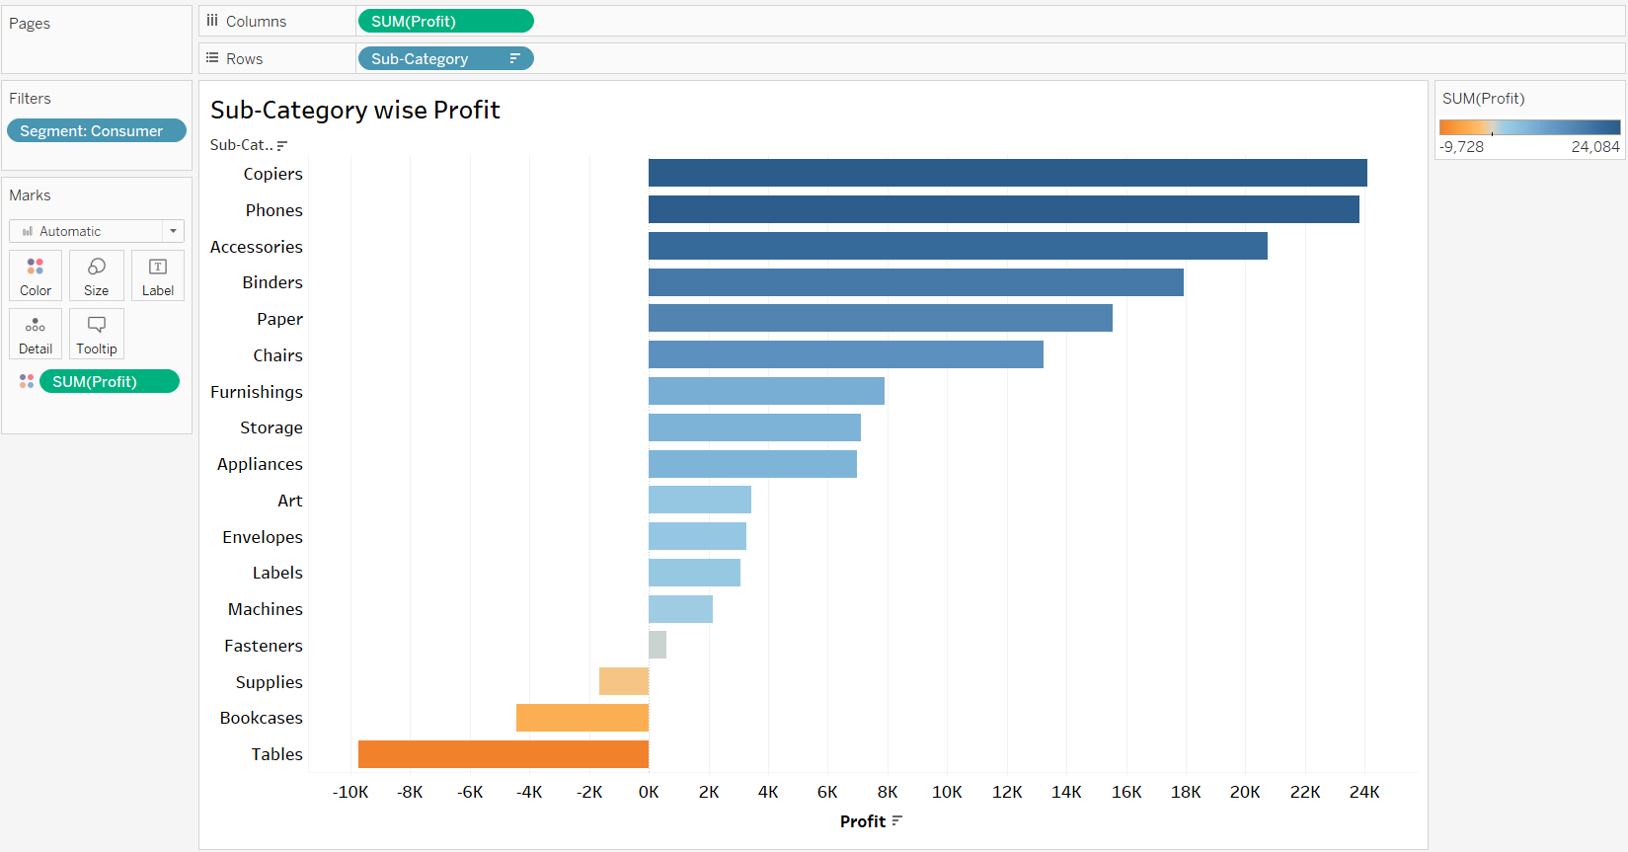
Expected output for problem 9a

Slide 18
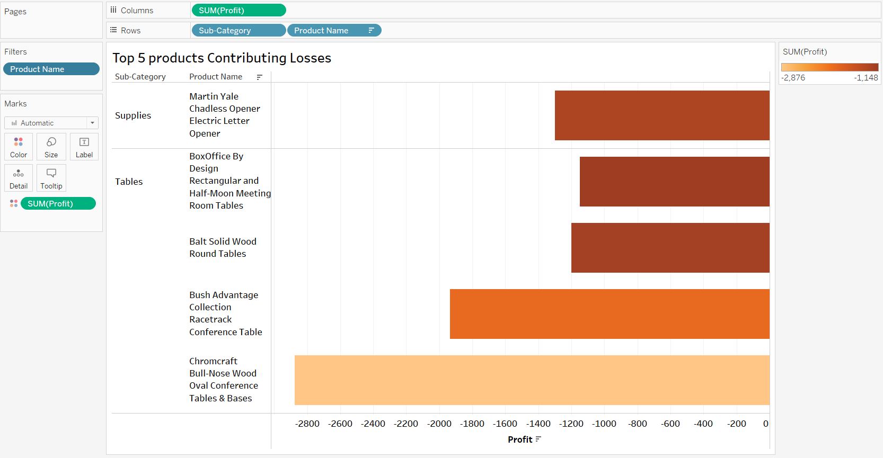
Expected output of problem 9b

Slide 19
Problem Statement 10
The management believes that in the city of Los Angeles, a small percentage of customers contribute towards a large share of profit. Check this by observing the output of the following task.
Display the distribution of customer counts and profit using a histogram with a bin size 150 and add a trend line for the city of Los Angeles.
Note: Compute the total profit by multiplying the customer count with the profit bin from the chart.
For e.g., 150*296, where 150 is the bin size and 296 is the number of customers who generated $150 as the profit.
The Expected Output is provided in the upcoming slide.

Slide 20
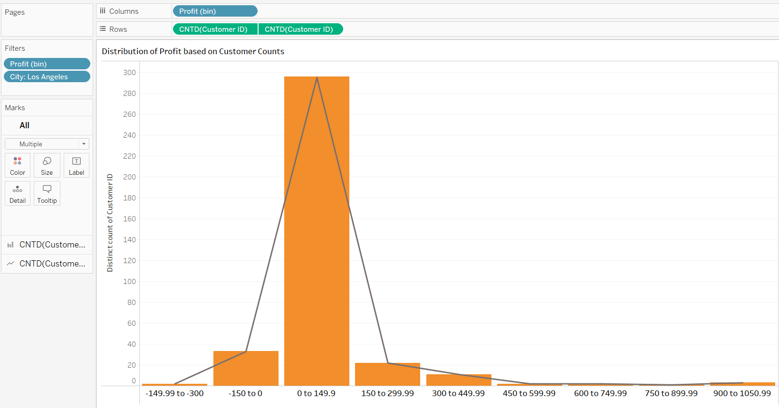
Expected output of problem 10

Slide 21
Problem statement 11
Display year-wise sales trend for the state of Florida for all three segments of products.
Which segment shows relatively increasing sales trend among the three segments from the year 2016 onwards?
The Expected Output is provided in the upcoming slide.

Slide 22
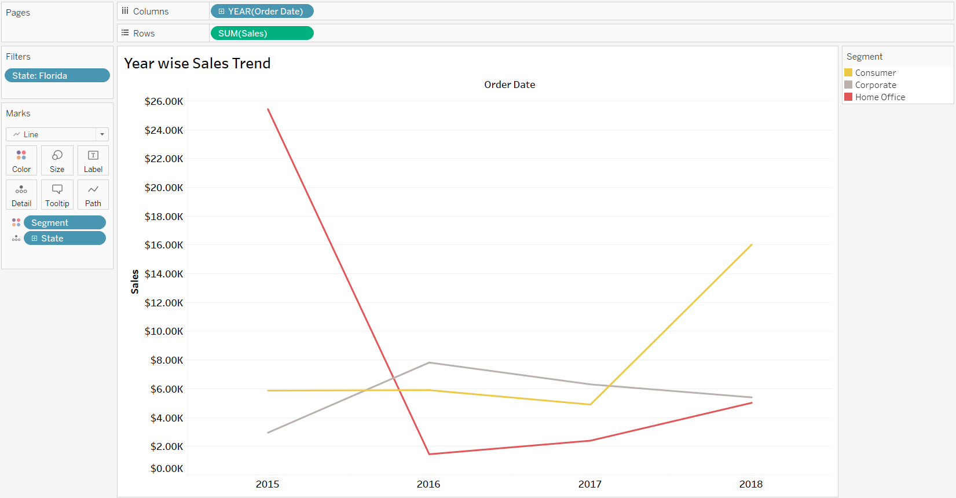
Expected output of problem 11

Slide 23
Problem Statement 12
The management wants to see segment-wise, state-wise sales trend for the years: 2015, 2016, 2017 and 2018.
Build an interactive dashboard that displays the details. Apply the below filters:
Action: Select the filter on the pie chart.
Action: Select the filter on Map chart.
Identify and write down at least three states, along with the segments, that have insignificant sales trend.
Note: The Expected output is available in the upcoming slides.

Slide 24
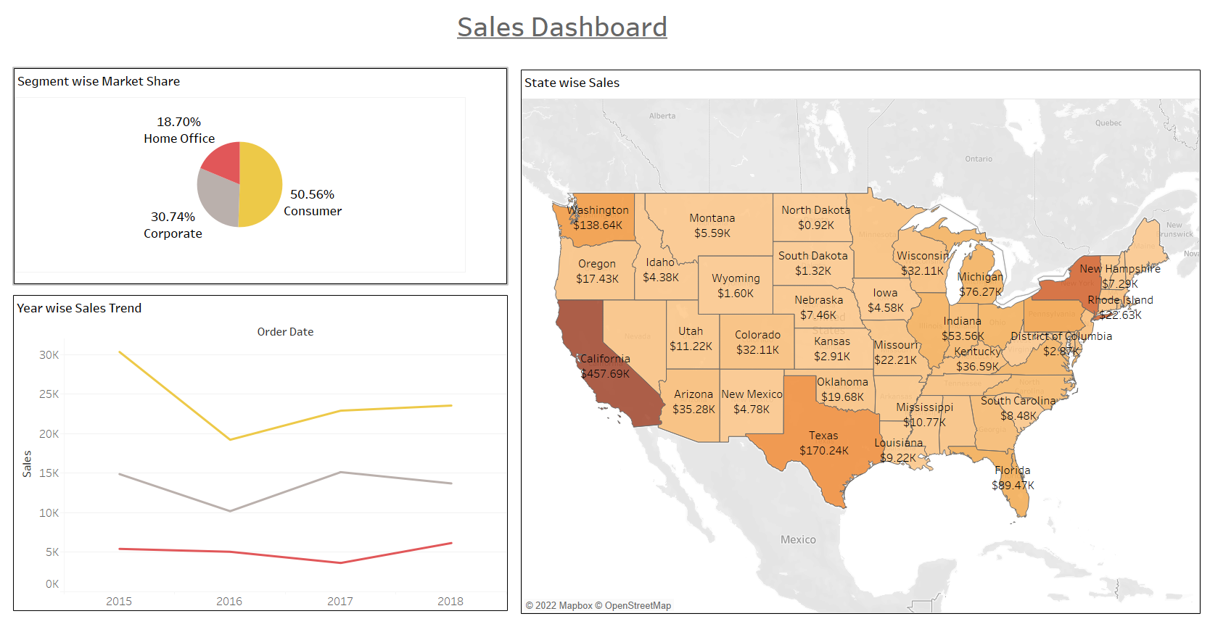
Expected Output

Slide 25
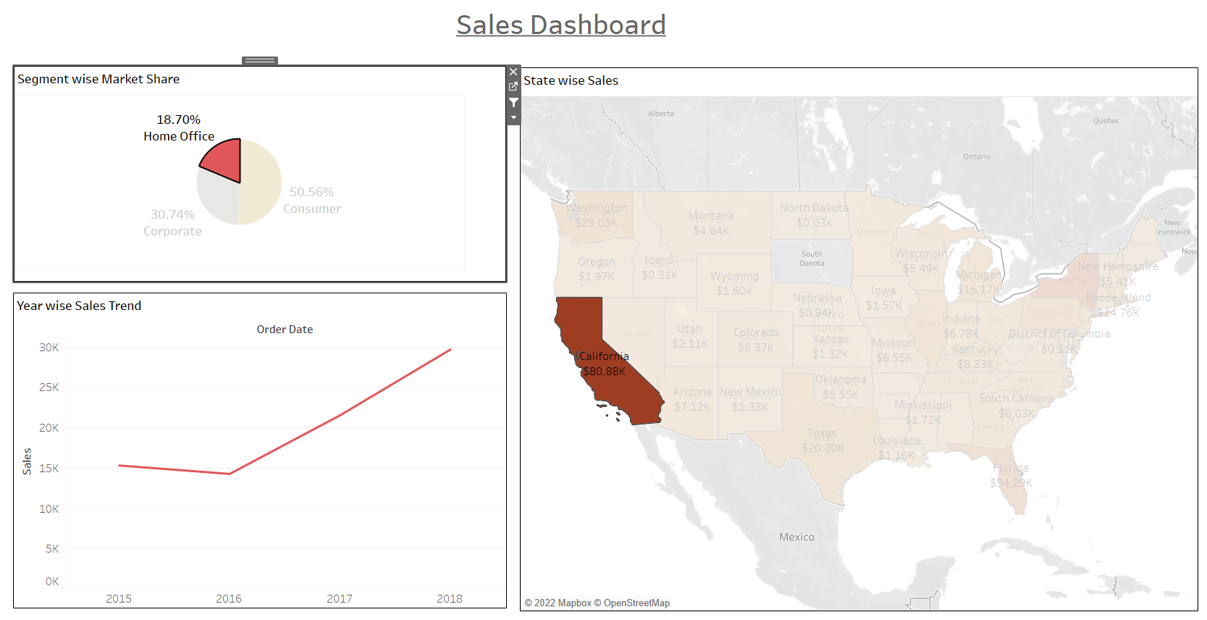
Expected output : Product wise and state wise sales trend in the same dashboard

Slide 26
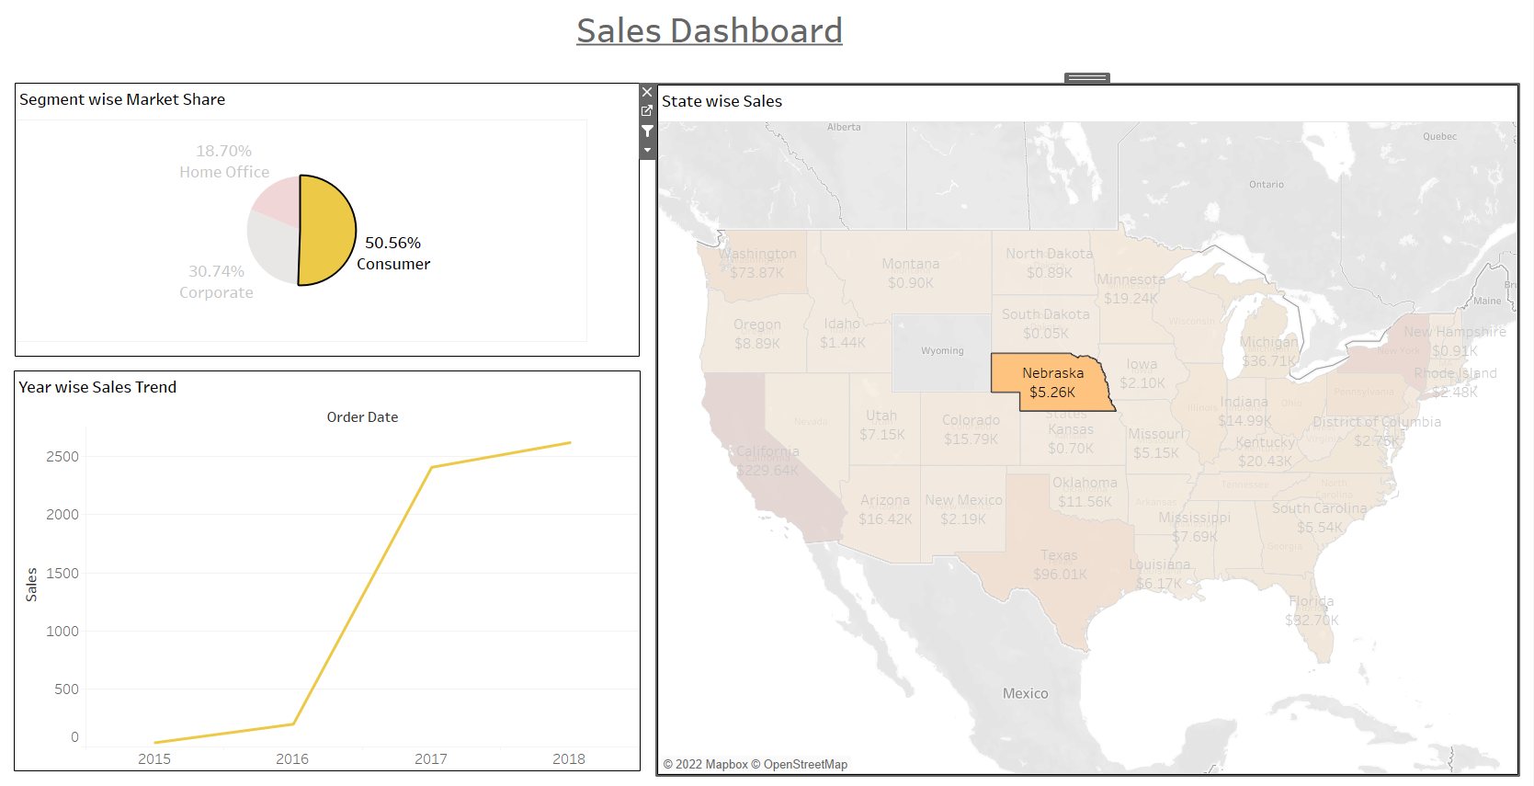
Sample output to demonstrate the interactive features in the sales dashboard

